Slide 1
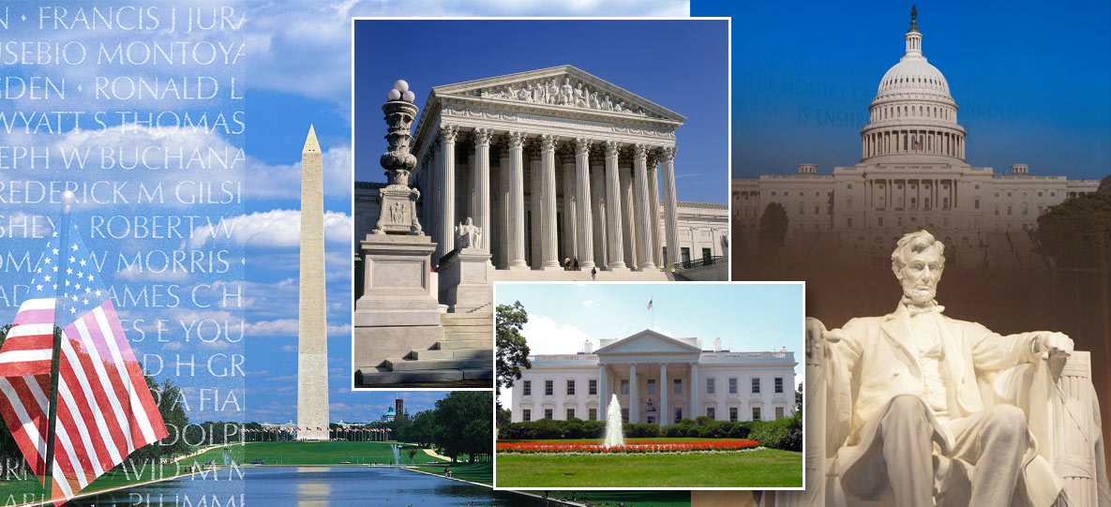

Jennifer Schaus & Associates
SERVICES FOR US FEDERAL GOVERNMENT CONTRACTORS
WEBINAR WEDNESDAYS – 2018
WASHINGTON, DC
OFFICE PHONE: 2 0 2 – 3 6 5 – 0 5 9 8

Slide 2
Jennifer Schaus & Associates – GOV CON WEBINAR SERIES - 2018 - WASHINGTON DC www.JenniferSchaus.com
Join Us for Our 2018 Series of Complimentary Webinars
on various US Federal Government Contracting Topics.
Presenters are industry experts
sharing knowledge
about the competitive government contracting sector.
Find all of our Govt Contracting webinars (free download) at www.JenniferSchaus.com
Contact Us @ 2 0 2 – 3 6 5 – 0 5 9 8

Slide 3
Jennifer Schaus & Associates – GOV CON WEBINAR SERIES - 2018 - WASHINGTON DC www.JenniferSchaus.com
REMINDERS:
All webinars are complimentary.
All webinars are recorded.
They are found on our website and on YouTube.
Please send your questions to the speaker directly.
Thank you for participating.

Slide 4
Jennifer Schaus & Associates – GOV CON WEBINAR SERIES - 2018 - WASHINGTON DC www.JenniferSchaus.com
ABOUT JENNIFER SCHAUS & ASSOCIATES:
Based in downtown Washington, DC;
A la carte services for Federal Contractors;
Proposal Writing to GSA Schedules, 8a Cert, Contract Admin & more!;
Educational webinars;
Networking events and seminars;
WEBSITE: http://www.JenniferSchaus.com

Slide 5
Jennifer Schaus & Associates – GOV CON WEBINAR SERIES - 2018 - WASHINGTON DC www.JenniferSchaus.com
In our weekly newsletter
OR
In our 2019 Webinar Wednesday Series
Contact Mallory.Flowers@JenniferSchaus.com for more information

Slide 6


Jennifer Schaus & Associates – GOV CON WEBINAR SERIES - 2018 - WASHINGTON DC www.JenniferSchaus.com
ABOUT OUR SPEAKER:
Mark Amadeo
            Over 20 years as government counsel & law firm counsel
            LL.M. Georgetown University Law Center; J.D. University of Wisconsin Law School; B.A. Boston College
            Founder & Managing Partner of Amadeo Law Firm, PLLC
            Focus on Government Contracting & Technology
              Review/negotiation: FAR/DFARS compliance
              Pre & Post Award Teaming: JV’s & Subcontracts
              Technology: IP preservation & commercialization

Slide 7
Jennifer Schaus & Associates – GOV CON WEBINAR SERIES - 2018 - WASHINGTON DC www.JenniferSchaus.com
Understanding GSA’s Price Reduction Clause
Wednesday, December 12, 2018

Slide 8
Jennifer Schaus & Associates – GOV CON WEBINAR SERIES - 2018 - WASHINGTON DC www.JenniferSchaus.com
Understanding GSA’s Price Reduction Clause
Federal Supply Schedule Program
                Simplified Process
                Commercial Supplies or Services
                Volume Prices

Slide 9
Jennifer Schaus & Associates – GOV CON WEBINAR SERIES - 2018 - WASHINGTON DC www.JenniferSchaus.com
Understanding GSA’s Price Reduction Clause
GSA Schedule Contract Process
                Prerequisites – 2 Years In Business, DUNS, SAM
                Identify Schedule Contract & Solicitation
                Proposal or Offer
                Price Proposal Template
                Labor Matrix (Personnel)
                Financial Statements
                Subcontracting Plan
                Technical Proposal
                Professional Compensation Plan
                Previous Cancellation/Rejection Letters
                EULAS
                Commercial Sales Practices (CSP)
                Commercial Price List
                Pricing Support Documentation
                Price Narrative
                Contract Officer Review & Price Negotiation
                Final Proposal

Slide 10
Jennifer Schaus & Associates – GOV CON WEBINAR SERIES - 2018 - WASHINGTON DC www.JenniferSchaus.com
Understanding GSA’s Price Reduction Clause
Price Reduction Clause
Before Contract Award – CO & Contractor Agree
                Basis of Award – Which Customers/Categories
                Gov’s Pricing/Discount Relationship With BOA
                Customers/Categories
                Relationship Maintained For Contract Period – So Tracking Required

Slide 11
Jennifer Schaus & Associates – GOV CON WEBINAR SERIES - 2018 - WASHINGTON DC www.JenniferSchaus.com
Understanding GSA’s Price Reduction Clause
When Is There A Price Reduction?
Any Change In Pricing or Discount Arrangement
                To Identified BOA Customers/Categories
                Disturbs Gov Price or Discount Relationship

Slide 12
Jennifer Schaus & Associates – GOV CON WEBINAR SERIES - 2018 - WASHINGTON DC www.JenniferSchaus.com
Understanding GSA’s Price Reduction Clause
When Is There A Price Reduction?
BOA Customers – 20% Discount Off Retail Price
GSA – 25% Discount Off Retail Price (5% Relationship)
New Price BOA Customers – 22% Discount Off Retail
GSA – 25% Discount Off Retail Price (3% Relationship)

Slide 13
Jennifer Schaus & Associates – GOV CON WEBINAR SERIES - 2018 - WASHINGTON DC www.JenniferSchaus.com
Understanding GSA’s Price Reduction Clause
What Happens If There Is A Price Reduction?
Contractor Must:
Offer the same price reduction
                Same Effective Date
                Same Time Period

Slide 14
Jennifer Schaus & Associates – GOV CON WEBINAR SERIES - 2018 - WASHINGTON DC www.JenniferSchaus.com
Understanding GSA’s Price Reduction Clause
What Happens If There Is A Price Reduction?
BOA Customers – 20% Discount Off Retail Price
GSA – 25% Discount Off Retail Price (5% Relationship)
New Price BOA Customers – 22% Discount Off Retail
GSA – 25% Discount Off Retail Price (3% Relationship)
New GSA
Price GSA – 27% Discount Off Retail (5% Relationship)

Slide 15
Jennifer Schaus & Associates – GOV CON WEBINAR SERIES - 2018 - WASHINGTON DC www.JenniferSchaus.com
Understanding GSA’s Price Reduction Clause
Exceptions
FFP, DQ Over Max Threshold
                Other Fed Agencies
                552.238-78 BOA Organizations
                Error in Billing or Quotation

Slide 16
Jennifer Schaus & Associates – GOV CON WEBINAR SERIES - 2018 - WASHINGTON DC www.JenniferSchaus.com
Understanding GSA’s Price Reduction Clause
Mandatory Reporting
During Contract Period Must Report To CO
All Price Reductions
                To BOA Customers/Categories
                Explanation of Conditions
                Notification Deadline – ASAP, but no later than 15 calendar days after effective

Slide 17
Jennifer Schaus & Associates – GOV CON WEBINAR SERIES - 2018 - WASHINGTON DC www.JenniferSchaus.com
Understanding GSA’s Price Reduction Clause
Deemed Price Reductions
Revisions to catalog, pricelists, schedules
                More favorable discounts or terms/conditions
                than in catalog, pricelists, schedules
                Special discounts to BOA customers/categories
                that disturbs Gov relationship

Slide 18
Jennifer Schaus & Associates – GOV CON WEBINAR SERIES - 2018 - WASHINGTON DC www.JenniferSchaus.com
Understanding GSA’s Price Reduction Clause
Avoiding PRC Triggers
Monitor advertisements/offers
                BOA Customer Pricing – Multiple Approvals
                Track Sales to BOA Customers
                Train Sales Team
                Document & Explain Temporary Discounts

Slide 19
Jennifer Schaus & Associates – GOV CON WEBINAR SERIES - 2018 - WASHINGTON DC www.JenniferSchaus.com
Understanding GSA’s Price Reduction Clause
Future of Price Reduction Clause
2016 GSAR Rule
                Moving from Vertical to Horizontal Model
                Pilot Program
                Transactional Data Reporting
                No CSP Disclosures
                Not Subject to BOA Customer Price Tracking

Slide 20
THANK YOU FOR ATTENDING!! WWW.JENNIFERSCHAUS.COM
QUESTIONS?
CONTACT OUR SPEAKER Mark Amadeo AT (202) 640-2090 AND AT mamadeo@amadeolaw.com
SERVICES FOR US FEDERAL CONTRACTORS OFFICE: 2 0 2 – 3 6 5 – 0 5 9 8

