Slide 1


Jennifer Schaus &
Associates
GOV CON WEBINAR SERIES - 2017

Slide 2
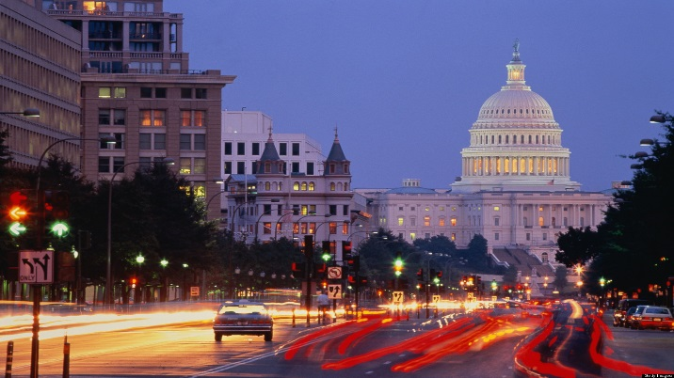
Jennifer Schaus & Associates – GOV CON WEBINAR SERIES - 2017 - WASHINGTON DC www.JenniferSchaus.com
Join Us for A Series of Complimentary Webinars
on various US Federal Government Contracting Topics.
Presenters are industry experts
sharing knowledge
about the competitive government contracting sector.
Find all of our Govt Contracting webinars (free download) at www.JenniferSchaus.com
Contact Us @ 2 0 2 – 3 6 5 – 0 5 9 8

Slide 3

Jennifer Schaus & Associates – GOV CON WEBINAR SERIES - 2017 - WASHINGTON DC www.JenniferSchaus.com
ABOUT JENNIFER SCHAUS & ASSOCIATES:
Based in downtown Washington, DC;
A la carte services for Federal Contractors;
Proposal Writing to GSA Schedules and Contract Administration, etc.;
Deep bench of industry experts;
Educational webinars;
Networking events and seminars;
WEBSITE: http://www.JenniferSchaus.com

Slide 4


Jennifer Schaus & Associates – GOV CON WEBINAR SERIES - 2017 - WASHINGTON DC www.JenniferSchaus.com
ABOUT JENNIFER SCHAUS:
Began career with D&B;
Over 20 years in federal contracting;
Industry speaker and author;
Board Member: GovLish; NCMA; and NMIA.
Volunteer Mentor &/or Instructor: VA PTAP; CBP / VBOC; Capitol Post; 1776; Eastern Foundry, WIT; WDCEP and the Towson University Incubator.

Slide 5

Jennifer Schaus & Associates – GOV CON WEBINAR SERIES - 2017 - WASHINGTON DC www.JenniferSchaus.com
ABOUT OUR SPEAKER
MARK A. AMADEO, ESQ.

Slide 6
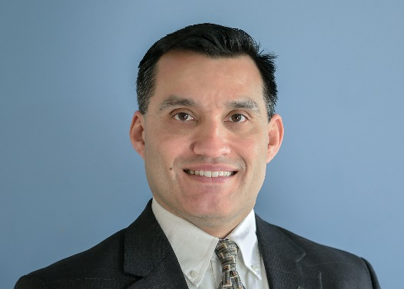
Jennifer Schaus & Associates – GOV CON WEBINAR SERIES - 2017 - WASHINGTON DC www.JenniferSchaus.com
ABOUT MARK A. AMADEO
      Founder & Managing Partner of Amadeo Law Firm, PLLC
      Over 20 years of experience as government counsel & law firm counsel
      Before starting boutique law firm, was a partner at DC law firm
      Litigation background in complex cases helps avoid pitfalls
      LL.M. Georgetown University Law Center; J.D. University of Wisconsin Law School; B.A. Boston College
      Member of several business, government contracting & technology groups in DC, Maryland & Virginia
      Phone: (202) 640-2090 Email: mamadeo@amadeolaw.com

Slide 7
Jennifer Schaus & Associates – GOV CON WEBINAR SERIES - 2017 - WASHINGTON DC www.JenniferSchaus.com
ABOUT AMADEO LAW FIRM, PLLC
          Boutique With Offices in DC, Bethesda & Frederick
          Focus on Government Contracting & Technology
            Review/negotiation: FAR/DFARS complianc
            Pre & Post Award Teaming: JV’s & Subcontracts
            Technology: IP preservation & commercialization
WEBSITE: http://www.amadeolaw.com

Slide 8
Jennifer Schaus & Associates – GOV CON WEBINAR SERIES - 2017 - WASHINGTON DC www.JenniferSchaus.com
FLOW DOWN CLAUSES FOR PRIMES & SUBS –
A CLOSER LOOK
Friday, August 25, 2017

Slide 9
Jennifer Schaus & Associates – GOV CON WEBINAR SERIES - 2017 - WASHINGTON DC www.JenniferSchaus.com
WHICH CLAUSES?
                FAR CLAUSES
                DFARS CLAUSES
                OTHER AGENCY SPECIFIC CLAUSES

Slide 10
Jennifer Schaus & Associates – GOV CON WEBINAR SERIES - 2017 - WASHINGTON DC www.JenniferSchaus.com
TWO KINDS OF FLOW DOWN CLAUSES
                MANDATORY
                OPTIONAL

Slide 11
Jennifer Schaus & Associates – GOV CON WEBINAR SERIES - 2017 - WASHINGTON DC www.JenniferSchaus.com
MANDATORY FLOW DOWN CLAUSES
STRUCTURE OF FAR & DFARS CLAUSE IMPLEMENTATION
                Implementing Rule
                FAR Part 52 Clause
                DFARS Part 252 Clause

Slide 12
Jennifer Schaus & Associates – GOV CON WEBINAR SERIES - 2017 - WASHINGTON DC www.JenniferSchaus.com
MANDATORY FLOW DOWN CLAUSES
WHICH SUBCONTRACTS?
                FAR Part 44 –Subcontracting Policies & Procedures
                Subcontract – Contract entered into by subcontractor to furnish supplies or services
                Includes purchase orders and changes or modifications
                Contract – mutually binding legal relationship obligating a seller to furnish supplies or services and buyer to pay for them
                Subcontractor – any vendor, supplier, distributor or firm that furnishes supplies or services to or for a prime or another subcontractor

Slide 13
Jennifer Schaus & Associates – GOV CON WEBINAR SERIES - 2017 - WASHINGTON DC www.JenniferSchaus.com
MANDATORY FLOW DOWN CLAUSES
                Read or be familiar with each clause in prime contract
                Review clauses incorporated by reference
                https://www.ecfr.gov/
                https://www.acquisition.gov
                May require minimum threshold
                May exclude certain subcontracts

Slide 14
Jennifer Schaus & Associates – GOV CON WEBINAR SERIES - 2017 - WASHINGTON DC www.JenniferSchaus.com
COMMERCIAL ITEM SUBCONTRACTS
FAR 2.101 – Commercial Items
                Items other than real property customarily used by the general public or non-government entities for non-governmental purposes – and
                Sold, leased or licensed to the general public; or
                Offered for sale, lease or license to the general public
                Variations and combinations of these items
                Services that are procured in support of these items
                Includes COTS

Slide 15
Jennifer Schaus & Associates – GOV CON WEBINAR SERIES - 2017 - WASHINGTON DC www.JenniferSchaus.com
COMMERCIAL ITEM SUBCONTRACTS
Mandatory Flow Downs
                FAR 52.212-5(e)(1) – Commercial Item Prime - 23 Clauses
                FAR 52.244-6 – When Prime is not for Commercial Item - 19 Clauses
                May include a minimum number of additional clauses

Slide 16
Jennifer Schaus & Associates – GOV CON WEBINAR SERIES - 2017 - WASHINGTON DC www.JenniferSchaus.com
INCORPORATE BY REFERENCE OR BY FULL TEXT
                FAR 52.102 – CO’s encouraged to incorporate by reference
                Blanket incorporation of prime contract
                Insurance Co. of North Amer. v. Aberdeen Ins. Serv. (5th Cir. 2001) - FAR clause must be “inserted”
                Look to flow down provision
                Include or incorporate the substance of the clause
                Include the requirement or include a similar requirement
                Insert the terms of the clause

Slide 17
Jennifer Schaus & Associates – GOV CON WEBINAR SERIES - 2017 - WASHINGTON DC www.JenniferSchaus.com
OPTIONAL FLOW DOWN CLAUSES
                Commercial Item Subcontracts
                Add otherwise mandatory clauses as necessary
                Clauses Concerning Essential Terms
                Termination For Convenience
                Changes Clause
                Price Reduction Clauses
                Disputes Clauses

Slide 18
Jennifer Schaus & Associates – GOV CON WEBINAR SERIES - 2017 - WASHINGTON DC www.JenniferSchaus.com
COMMON ISSUES
                Prime/Sub Always Does It This Way
                All FAR or DFARS Clauses Inserted
                Every Possible Flow Down Clause Incorporated

Slide 19
Jennifer Schaus & Associates
GOV CON WEBINAR SERIES - 2017
QUESTIONS?
CONTACT OUR SPEAKER (MARK A. AMADEO) AT (202-640-2090) AND AT (mamadeo@amadeolaw.com)
THANK YOU FOR ATTENDING!! WWW.JENNIFERSCHAUS.COM

