Slide 1
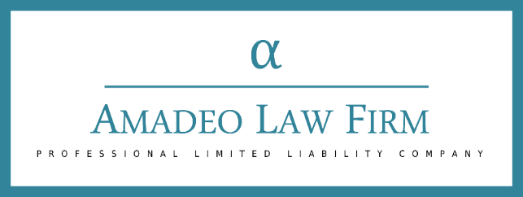
The SBA’s Women-Owned Small Business Program
March 25, 2021
Presented By
Mark A. Amadeo

Slide 2
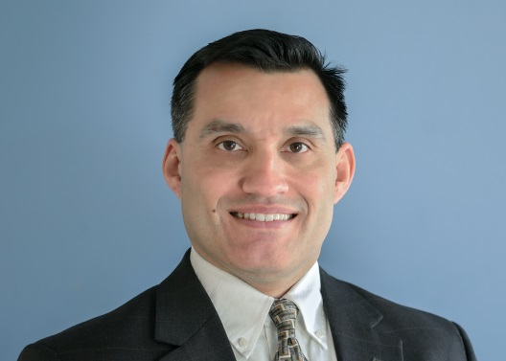
The SBA’s Women-Owned Small Business Program
INTRODUCTIONS
Mark A. Amadeo
Over 20 years experience as government counsel & law firm counsel
LL.M. Georgetown University Law Center; J.D. University of Wisconsin Law School; B.A. Boston College
Founder & Managing Partner of Amadeo Law Firm, PLLC
Focus on Government Contracting & Technology
  Review/negotiation: FAR/DFARS Compliance
  Pre & Post Award Teaming, JV’s & Subcontracts
  Technology: IP Preservation & Commercialization

Slide 3
The SBA’s Women-Owned Small Business Program
March 25, 2021

Slide 4
The SBA’s Women-Owned Small Business Program
Federal Government Goals
5% of all prime contract and subcontracts
FY 2019 WO Prime - 5.19% - $26 billion - highest
WOSB Program - set-asides and sole source awards

Slide 5
The SBA’s Women-Owned Small Business Program
Eligibility
WOSB
Concern - for profit (startups ok)
Size – Small
Ownership – at least 51% unconditionally directly by U.S. women
Control – at least 51% unconditionally directly by U.S. women
EDWOSB
Women who own/control 51% must be economically disadvantaged

Slide 6
The SBA’s Women-Owned Small Business Program
Eligibility
Unconditional Control/Ownership
All owners & advisors must come to terms
SBA - strict and unforgiving

Slide 7
The SBA’s Women-Owned Small Business Program
Eligibility
51% (Majority) Ownership
Direct
Must be direct, not through another business or entity
Unconditional
Not subject to any conditions on ownership benefits

Slide 8
The SBA’s Women-Owned Small Business Program
Eligibility
51% (Majority) Ownership
Partnership - at least 51% of each class of partnership - reflected in partnership agreement
LLC - at least 51% of each class of member interest
Corporation - at least 51% of each class of voting stock & 51% of all stock outstanding

Slide 9
The SBA’s Women-Owned Small Business Program
Eligibility
Control
Management and daily business operations
Long-term decisions and day-to-day operations

Slide 10
The SBA’s Women-Owned Small Business Program
Eligibility
Management Control
Highest Position - qualifying owner
Necessary management experience but technical expertise or license not required
If has ultimate control over those that have
Manage full-time basis during normal working hours
No outside employment if prevents time and attention to daily affairs

Slide 11
The SBA’s Women-Owned Small Business Program
Eligibility
Management Control
Partnership - must serve as a general partner
LLC - must serve as management member, control over ALL decisions of the LLC
Corporation - must control Board of Directors
Own at least 51% of voting stock, on BOD and can overcome supermajority requirements; or
Comprise majority of voting directors (by number/weighted voting)

Slide 12
The SBA’s Women-Owned Small Business Program
Eligibility
Management Control
Men & Other Entities
Can be involved in management
Can be stockholders, partners & LLC members
Can’t exercise control or have power to control
If man has required license & equity - may be found to control

Slide 13
The SBA’s Women-Owned Small Business Program
Eligibility
EDWOSB - QO - Economically Disadvantaged
Personal Net Worth - less than $750K
Income - 3yr AGI can’t be over $350K
FMV - assets must not exceed $6 million
MAY consider spouse’s info, but WILL consider if spouse has a role in company or lent or guaranteed a loan

Slide 14
The SBA’s Women-Owned Small Business Program
Certification
Benefits
WOSB & EDWOSB set-asides & sole-source under WOSB Program
But not all NAICS codes are eligible
Every 5 years - SBA reviews NAICS codes list
If not seeking set-asides/sole source can self-certify & also counts toward agency goals

Slide 15
The SBA’s Women-Owned Small Business Program
Certification
SAM
SBA
Free
Apply through beta.certify.sba.gov
Checklists, knowledge base
Third Party Certification
Fees - $350-$400 or more
Begin process with TPC
Upload in beta.certify.sba.gov
Existing 8(a), VOB/SDVOSB Certifications

Slide 16
The SBA’s Women-Owned Small Business Program
Certification
SBA Timeline
15 days - complete/incomplete
90 days - approval/declined
Declined by SBA or TPC
Can reapply in 90 days
Delays/RFI’s
Non-matching DUNS, Tax ID, MPINS
Women owners not POC
Not completed - attestation & e-signature

Slide 17
The SBA’s Women-Owned Small Business Program
Certification
Must represent annually continue to meet eligibility requirements
Re-examination every 3 years

Slide 18
The SBA’s Consolidated
All Small Mentor-Protégé Program
Questions?
Contact:
Mr. Mark A. Amadeo
Washington DC
+ 1 - 2 0 2 – 6 4 0 – 2 0 9 0
mamadeo@amadeolaw.com
www.amadeolaw.com

Slide 19
Expanded Government Contracting
Opportunities For Joint Ventures
THANK YOU FOR JOINING OUR WEBINAR!
The Recorded Webinar Can Be Found Here:
http://amadeolaw.com/index.php/firm-resources/webinars

